Slide 1
Group Project: 100W Solar Panel
EECT 175
5/6/16
Olivia Koehler, Spencer Richter & Codey Fletcher

Slide 2
Table of Content
Olivia Koehler’s Final Project: (Site Audit for Solar Panel) Pg.3
Spencer Richter: (Block Diagram of 100w Solar Panel) Pg. 32
Codey Fletcher: (TBD) Pg. 34

Slide 3
Site Audit for Solar Panel
By: Olivia Koehler
EECT 175
5/6/16

Slide 4
Site Audit for Solar Panel: Layout with List
Evaluating Your Site For Solar Energy Pg. 3
Path of Sun Across the Sky Pg. 10
Obstacle Survey Pg. 14
Doing the Site Survey Pg. 20
End Result Pg. 26
Resources Pg. 29

Slide 5
Evaluating Your Site For Solar Energy

Slide 6

Evaluating Your Site For Solar Energy
Does your location get enough sun?
Do nearby obstacles at your location block too much sun??

Slide 7
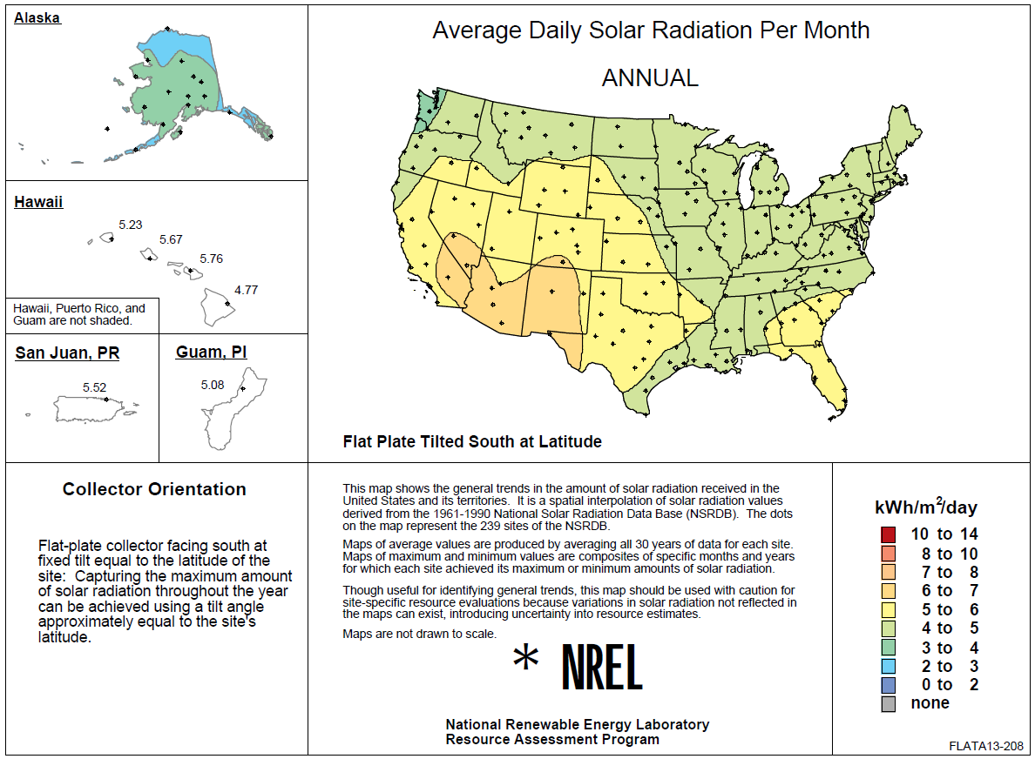
Average Daily Solar Radiation Per Month
- Within the US, almost all locations get enough sun to successfully use solar energy, but some are better than others.
- According to this chart, Indiana receives about 4 to 5 kWh/m²/day

Slide 8
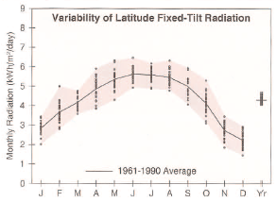
Fort Wayne, IN
Latitude: 41.00° N
Longitude:85.20 ° W
Elevation: 252 meters
Mean Pressure: 987 milibars
This chart show what the average amount of radiation received monthly through the years 1961-1990 in Fort Wayne Indiana were.

Slide 9
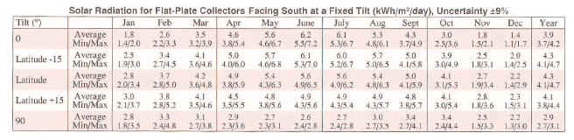
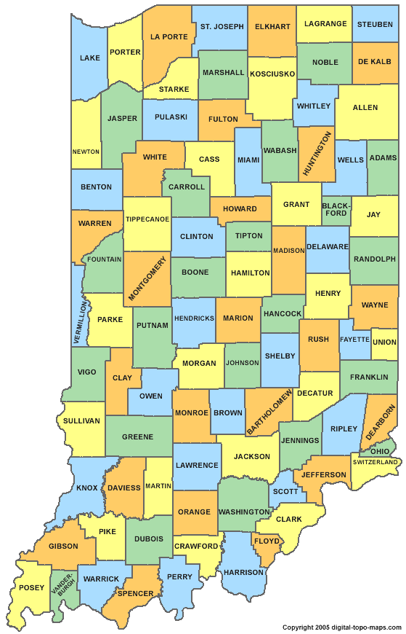
It is important to know how good the solar recourses are in one’s location.

Slide 10
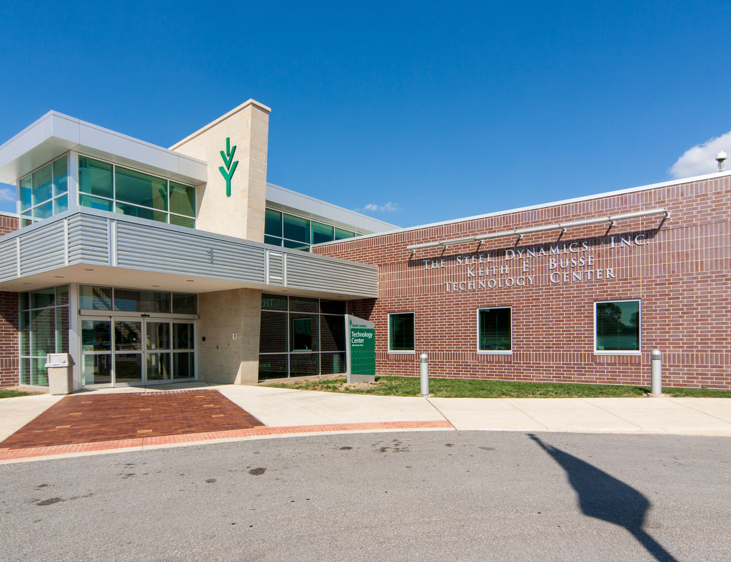
Obstacle Survey
Its critically important to go through a site survey to make sure that you actually get good sun on the collectors enough of the day and enough to get good results.

Slide 11

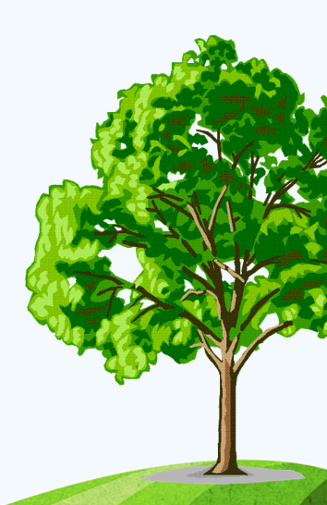
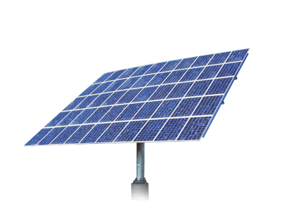
Obstacle Survey
Not surprisingly, the sun must actually shine on a solar collector in order for it to collect useful energy.
More surprisingly, some solar projects are built that never meet expectations because obstacles block the sun.

Slide 12
Path of Sun Across the Sky

Slide 13
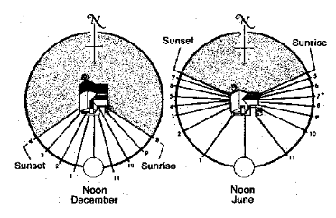
Path of Sun Across the Sky
The path of the sun across the sky changes with the time of year. This is why its important to do this obstacle survey, and not just stick your head out the window and see what the sun is shining on today.

Slide 14
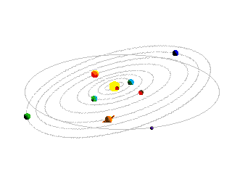

- In planning a solar collector location, it is important to make sure that the sun will shine on the collector during all the parts of the year that you want it to.

Slide 15
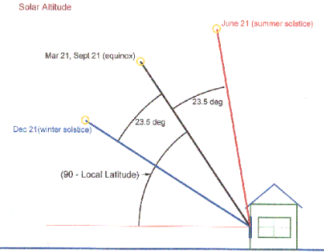
- At the two equinoxes, the sun rises due east and sets due west. At solar noon on the equinoxes, the altitude of the sun is 90 minus the local latitude. The spring equinox occurs on Mar 21st, and the fall equinox on Sept 21st.
- The winter solstice is the shortest day of the year and occurs on Dec 21st. On this day the sun will rise well to the south of east, and will set well to the south of west.
- The summer solstice is the longest day of the year and occurs on June 21st. On this day the sun will rise well to the north of east, and will set well to the north of west.

Slide 16
Obstacle Survey

Slide 17
Obstacle Survey
The obstacle survey lets you check for blockage of the sun by building, trees, hills etc.
Things needed to run experiment:
- A Sun Chart for your area
- A device to measure elevation and azimuth angles
- Compass

Slide 18
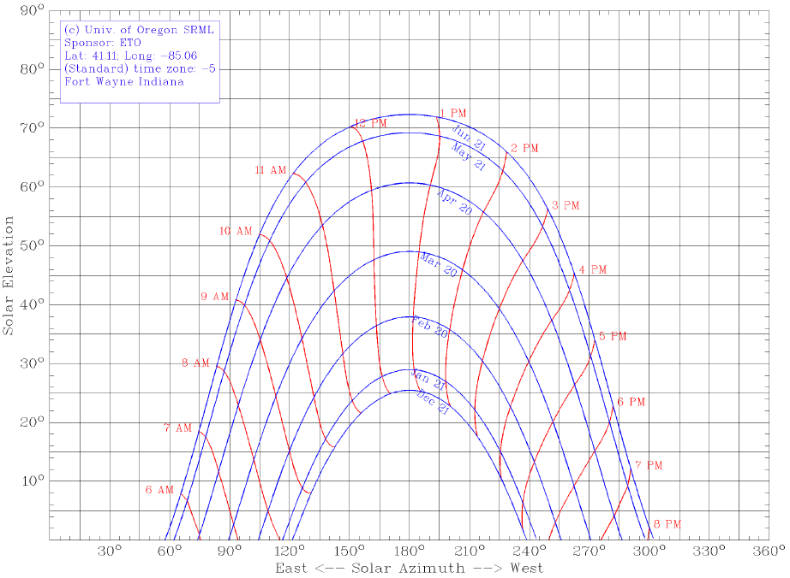
Sun Chart

Slide 19
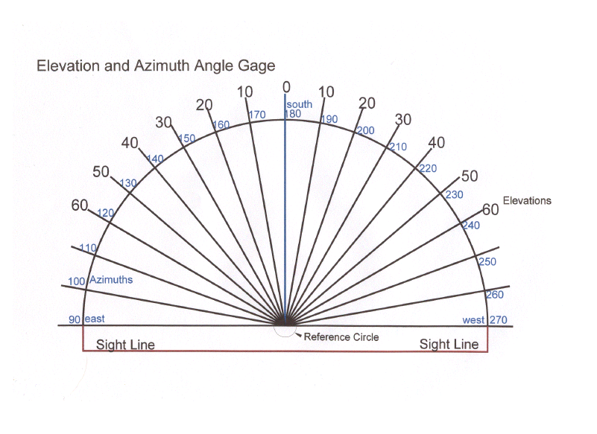
Solar Elevation and Azimuth Gage

Slide 20
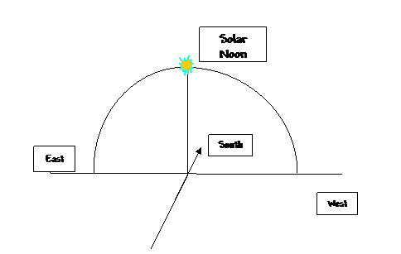
Determine where true south is
One must be able to locate where solar south is, because to take proper measurements one must measure the azimuth and elevation angles for each of the high points along the horizon.

Slide 21
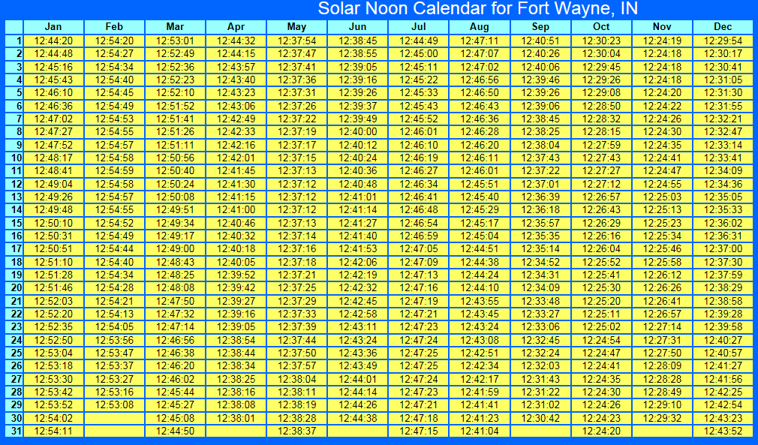
Solar Noon Calendar

Slide 22
Doing the Site Survey

Slide 23
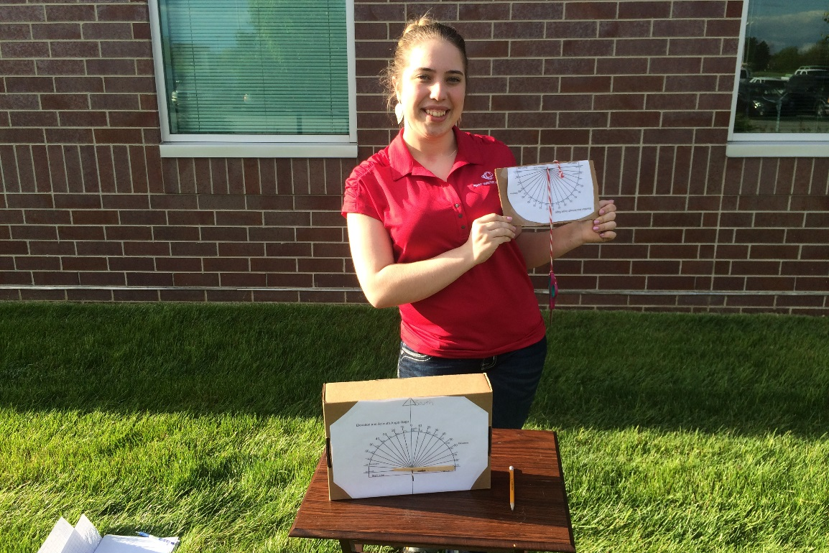
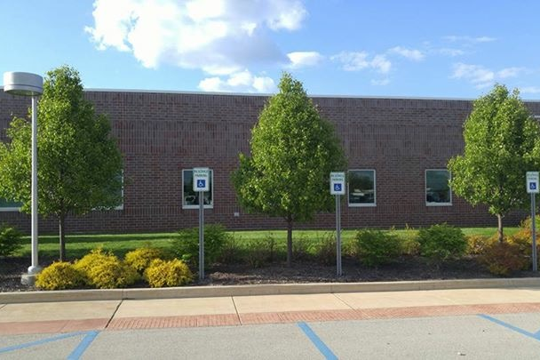
Using to measuring gages, I went out to the spot selected by my professor and myself and measured the obstacle horizon.
The place chosen to examine is outside of the Steel Dynamics building, a small opening outside of my professors office.

Slide 24
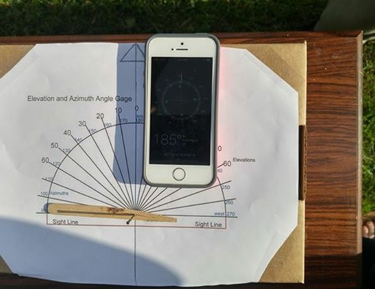
Measuring the azimuth angles
Compass
Pointing
South
Starting from northeast to northwest the azimuth angles of objects were recorded. Using a pointer attached to the gage, the angle were noted when it lined up with an object.

Slide 25
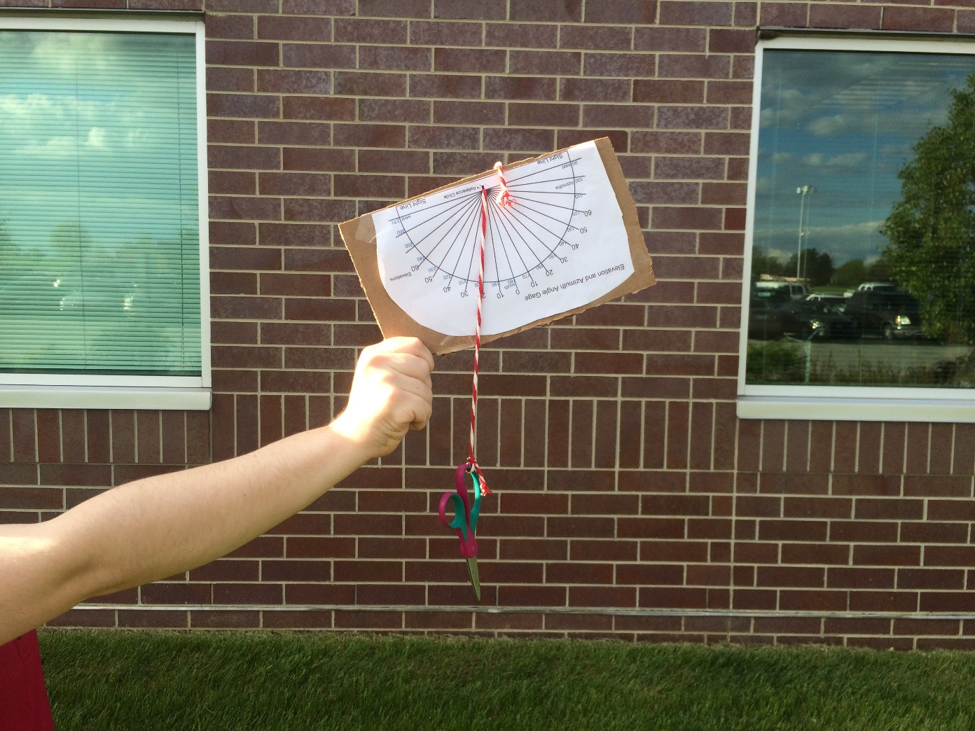
Measuring the elevation angles
Sight Line
The elevation gage, had a string and a weight attached to it; the gage would be held up to measure an objects elevation. The gage would be lined up using the sight line; wherever the string would cross the elevation scale those values were then recorded. The values were then plotted in unison with the azimuth angles onto a sun chart.

Slide 26
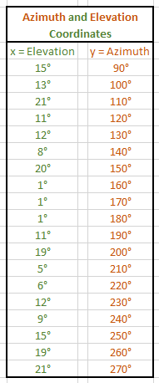
Plot Points
These are all of the data points which were collected during the obstacle survey.
X represents the Elevation Angle
Y represents the Azimuth Angle

Slide 27
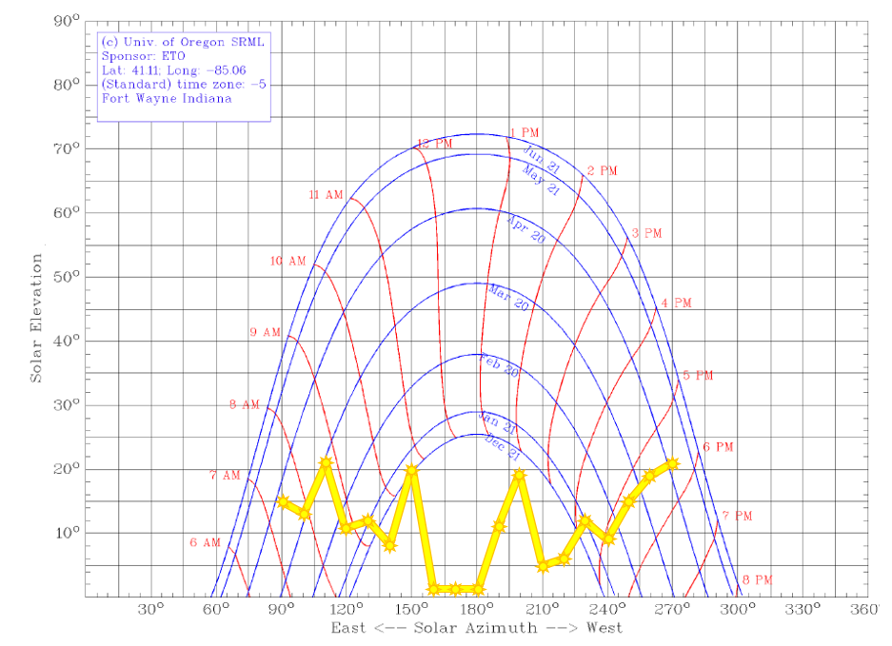
Sun Chart w/ Obstacle Horizon
Both the azimuth and elevation angles were plotted onto this sun chart, which shows the position of the sun for every minute of the year. The yellow line plotted on the chart will show the obstacle horizon, these are the points when the solar panel would get the least amount of sun.

Slide 28
End Result

Slide 29
End Result
As long as five to six hours of unblocked sun is collected focused around solar noon, the position of the solar panel will be fine.
However, if a blockage occurs for this six hour period a new evaluation needs to be made.
According to the chart plotted previously, the month of December will be when the least amount of sunlight will be collected. The best time to collect solar energy will be in the months of April, May and June.

Slide 30
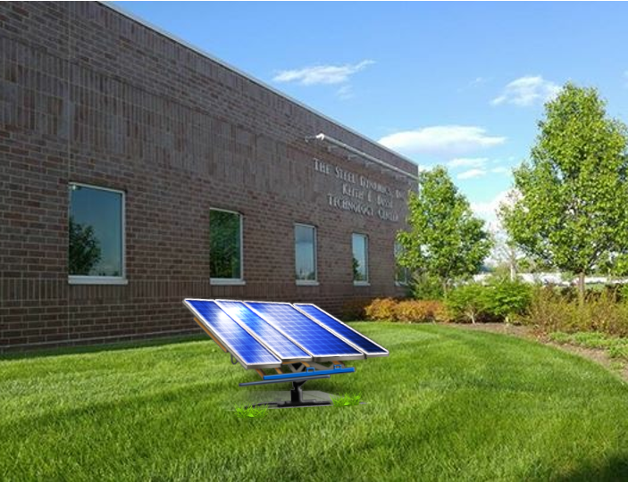
End Result
This location will work to place a 100W solar panel. The obstacles are at a minimum, and the sunlight received in this location is applicable.

Slide 31
Recourses
http://www.builditsolar.com/SiteSurvey/US%20Sol%20Rad%20Map.pdf (solar resources map)
http://rredc.nrel.gov/solar/pubs/redbook/ (sun available at US cities)
http://solardat.uoregon.edu/SunChartProgram.html (Sun Charts)
http://www.builditsolar.com/SiteSurvey/ElevAzGage.pdf (Solar Elevation and Azimuth Gage)
http://www.builditsolar.com/SiteSurvey/FindingSouth.htm (determine where true south is)

Slide 32
Block Diagram of 100W Solar Panel
By: Spencer Richter
EECT 175
5/6/16

Slide 33
SOLAR PANEL
AC FLOW
CHARGE CONTROLER
DC FLOW
INVERTER
DC FLOW
BATTERY
AC FLOW
APPLIANCE

Slide 34
Cody Fletcher
I contacted him (Cody Fletcher) previously about turning in his slides to me (Olivia Koehler), so we as a group could submit one PowerPoint. However, I never heard back from him, I did reach out again and still no reply. I am going to send him a message notifying him that I am submitting it without him because I ran out of time to wait. . With hopes he will turn his portion in on his own.

